Slide 1
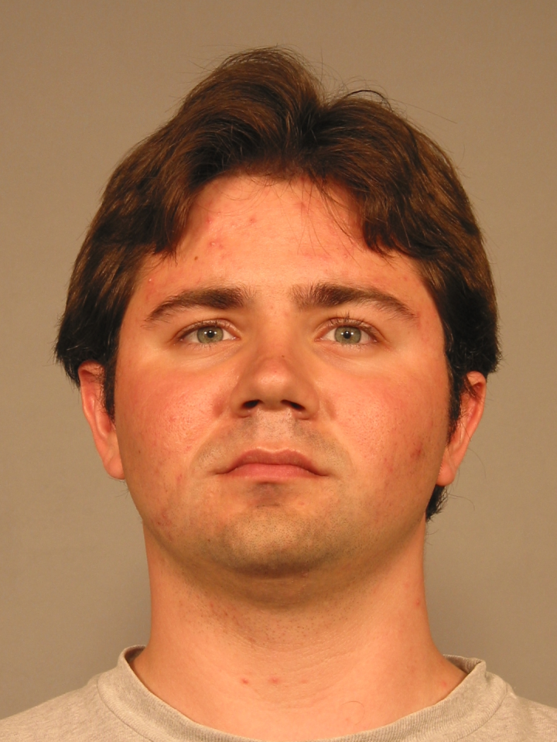
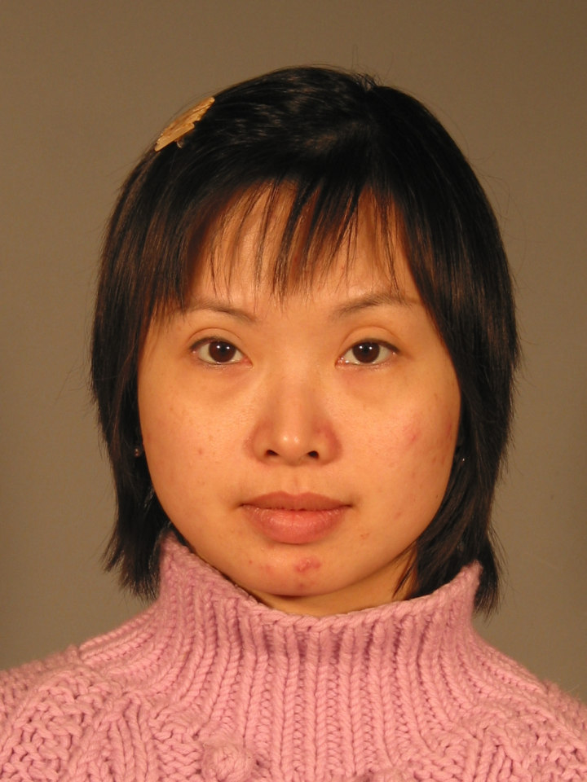
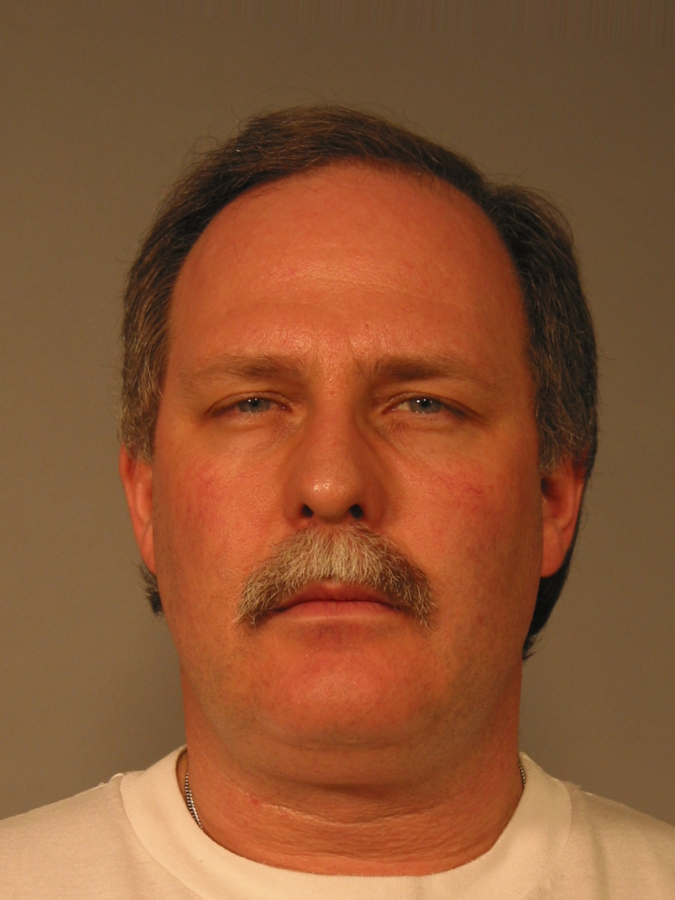
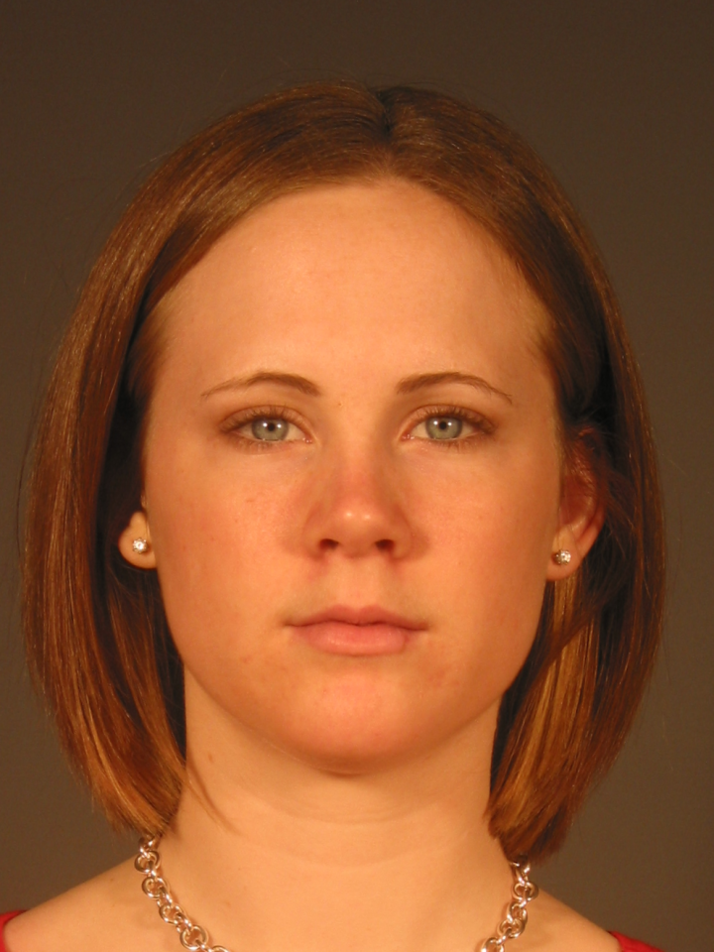
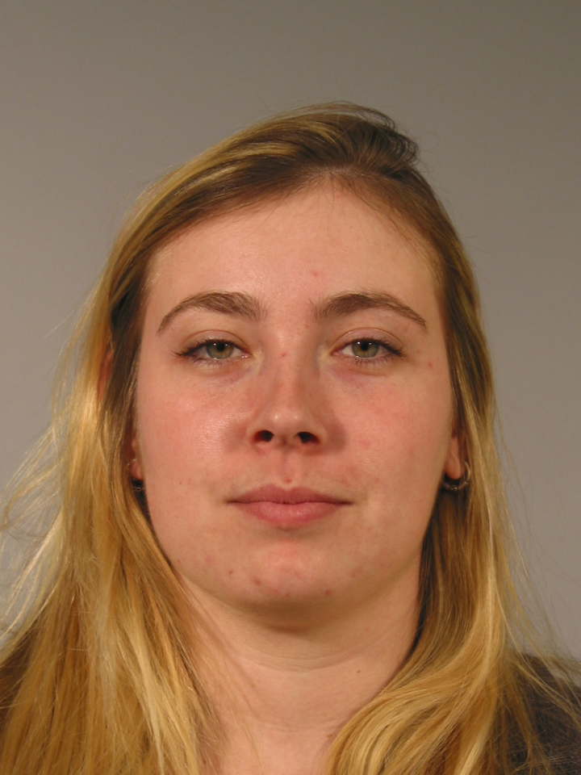
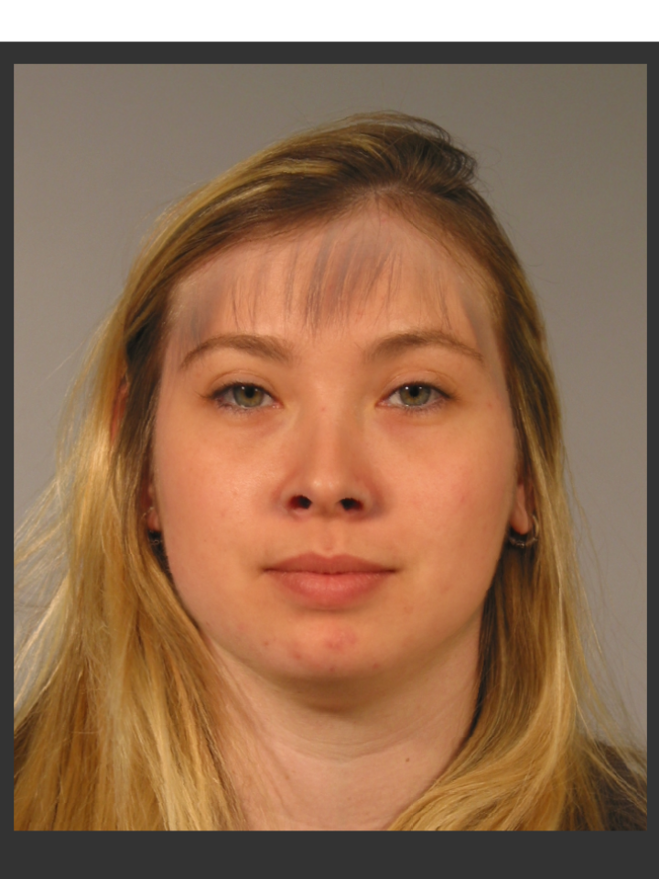
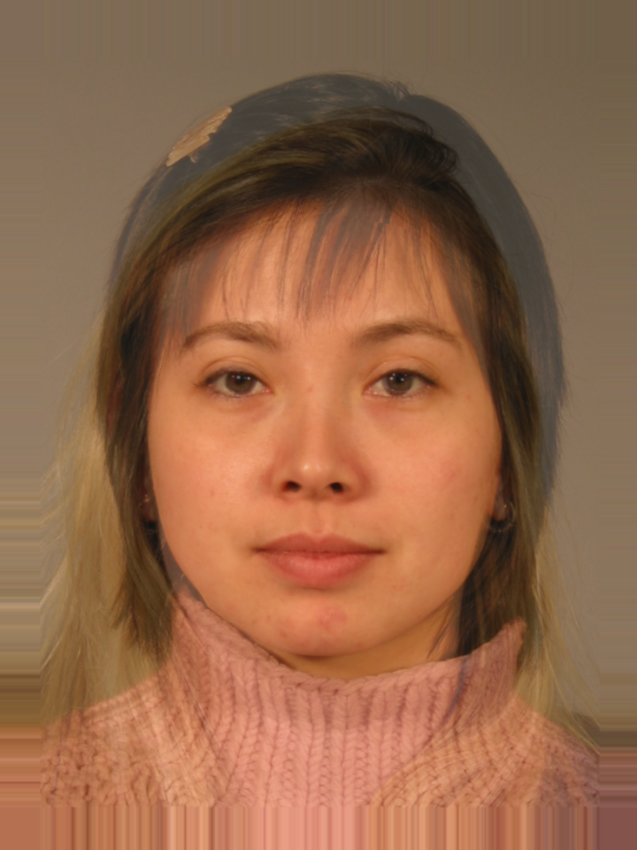
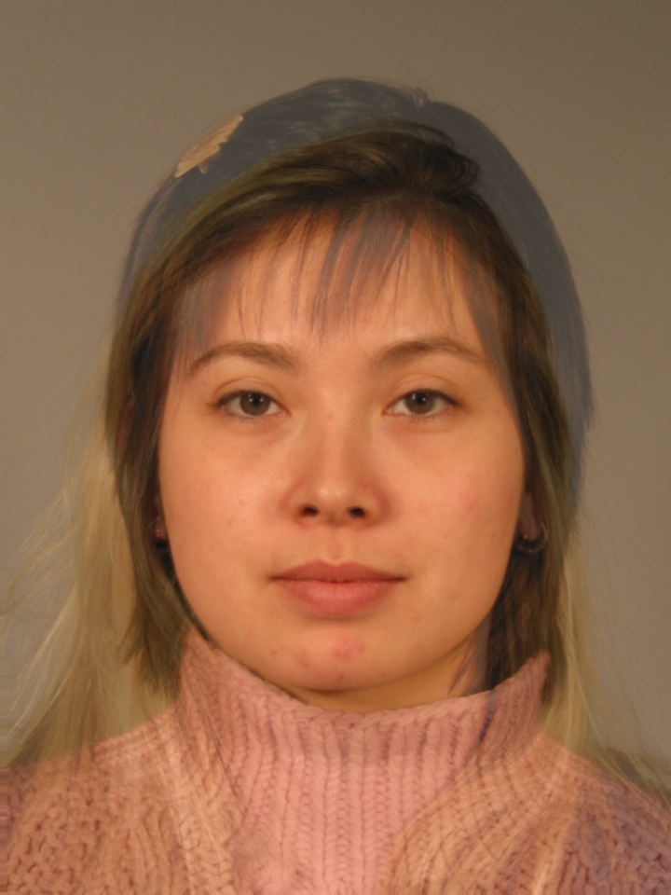

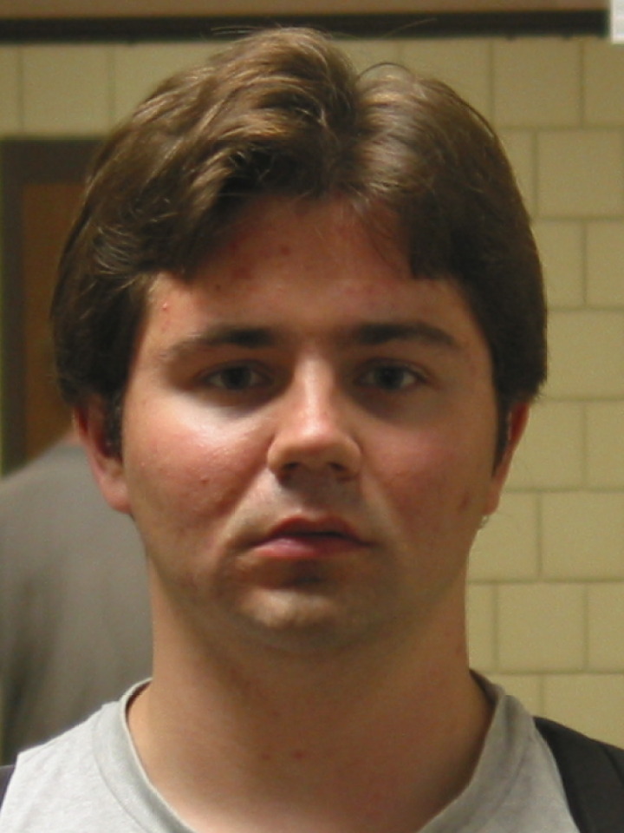
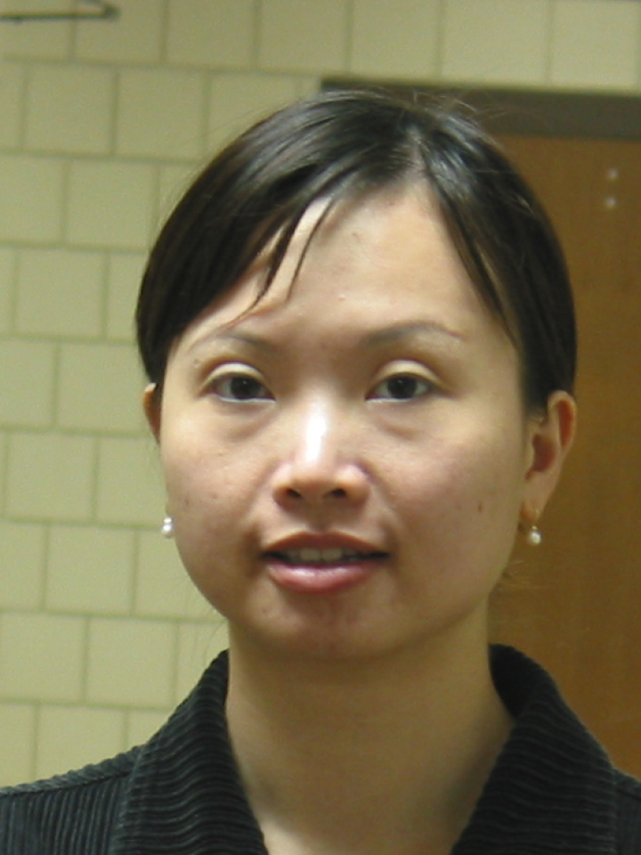

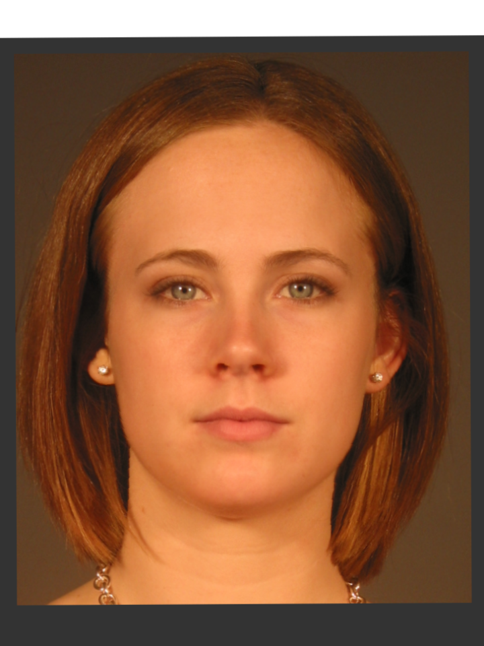
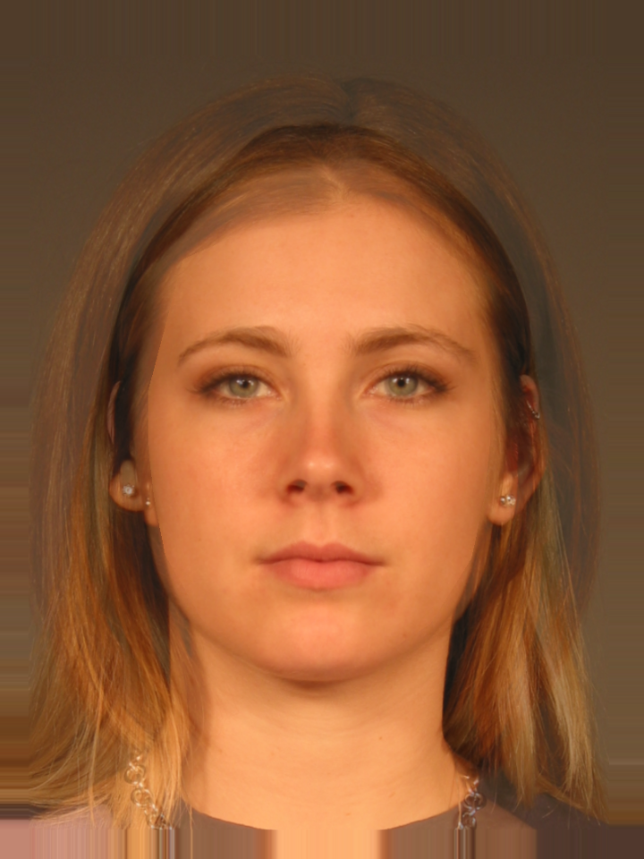
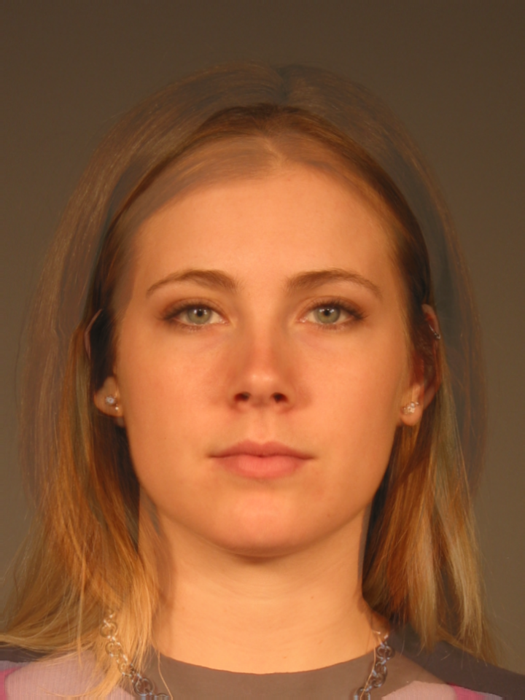
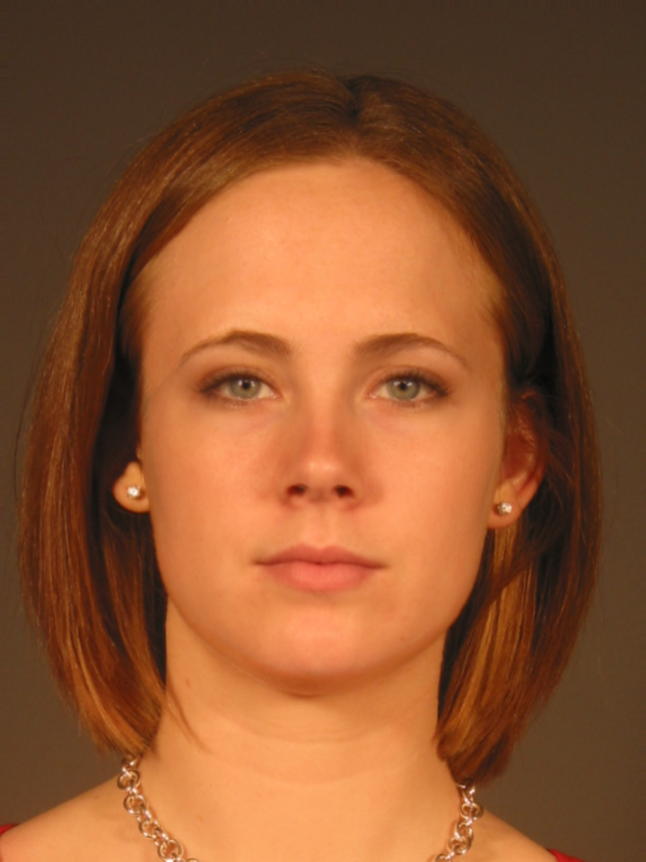
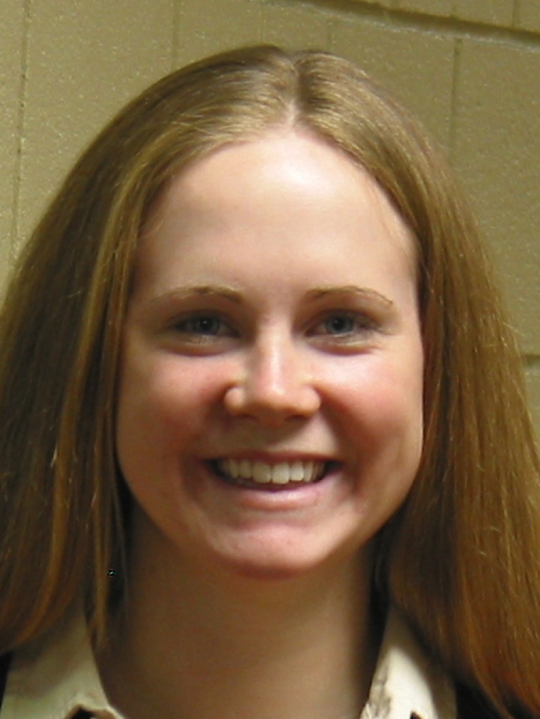
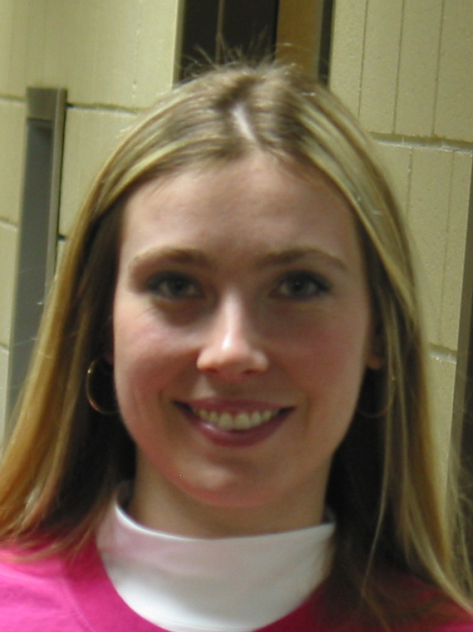
FRGC (Reference)
X 1441 images
(2 faces not recognized)
1. Reference Database Preprocessing
FRGC (Probe)
FRGC (Probe) Light
FRGC (Probe)
Morphing Approaches
Face Fusion (1)
Face Morpher (2)
Open CV (3)
UBO (4)
2. Face Morphing
3. Moved (Baseline) Database
3. Probe Database
(1)
(2)
(3)
(4)
Models
"VGG-Face"
"Facenet"
"Facenet512"
"OpenFace"
"DeepFace"
"DeepID"
"ArcFace"
"SFace"
Evaluation
Cosine Similarity
Threshold
Accuracy
Feature Recognition
4. Model Evaluation

